Slide 1
Analysis of Machine Learning Methods on Image Classification Problem
TEAM MEMBERS
Müslim Yılmaz
Ömer Kibar

Slide 2

ABOUT PROJECT
In this project, we will study various machine learning approaches on image classification and make comprehensive comparison between them. Our study includes:
Supervised Learning,
Semi-supervised learning,
Federated learning.

Slide 3

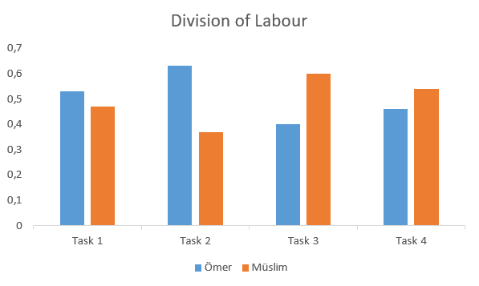
DIVISION OF LABOUR
Task 1: Determining CNN Architecture and supervised learning
Task 2: Semi-supervised learning part
Task 3: Federated learning part
Task 4: Reports and presentation preparation

Slide 4

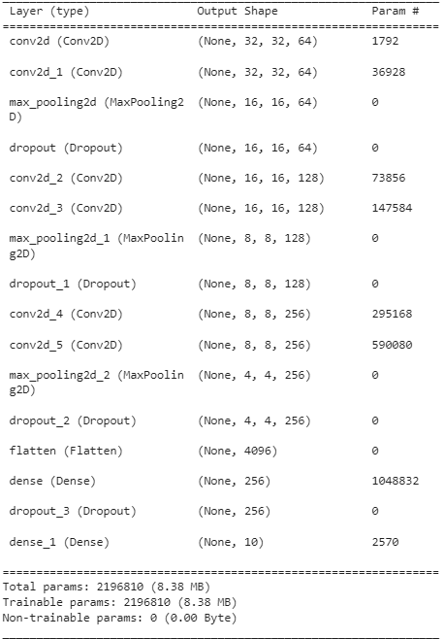
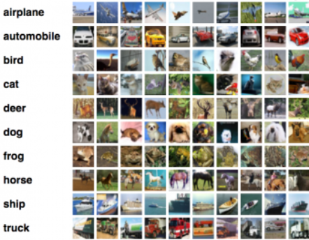
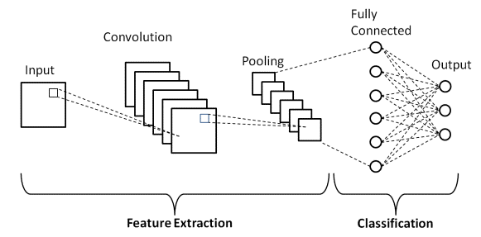
DATASETS AND BASE MODEL
CIFAR-10
SIMPLE CNN
60000 images in 10 classes, with 6000 images per class.
50000 training images and 10000 test images.
Consist of convolutional, max pooling, dropout, flatten and denser layers.
Trainable parameters amount to 2,196,810.
*CIFAR-10:(2018). Kaggle. https://www.kaggle.com/c/cifar-10/

Slide 5
SUPERVISED LEARNING SETUP
Traditional approach.
Input shape = (32,32,3); Output class = 10
70 epoch with parameters:
Learning Rate = 0.001,
Batch size = 64, Momentum = 0.9
SGD, Categorical-Crossentropy.
One-hot encoding for labels.

Slide 6
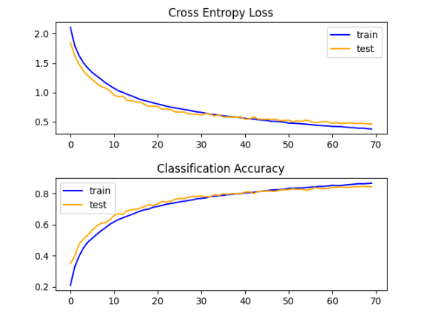
SUPERVISED LEARNING RESULTS
We reached %84.53 overall accuracy.
Is there any anomaly present within this graph that warrants attention or analysis?
Hint: Think about Droput Layers
Figure 1. Supervised learning loss and accuracy figures

Slide 7
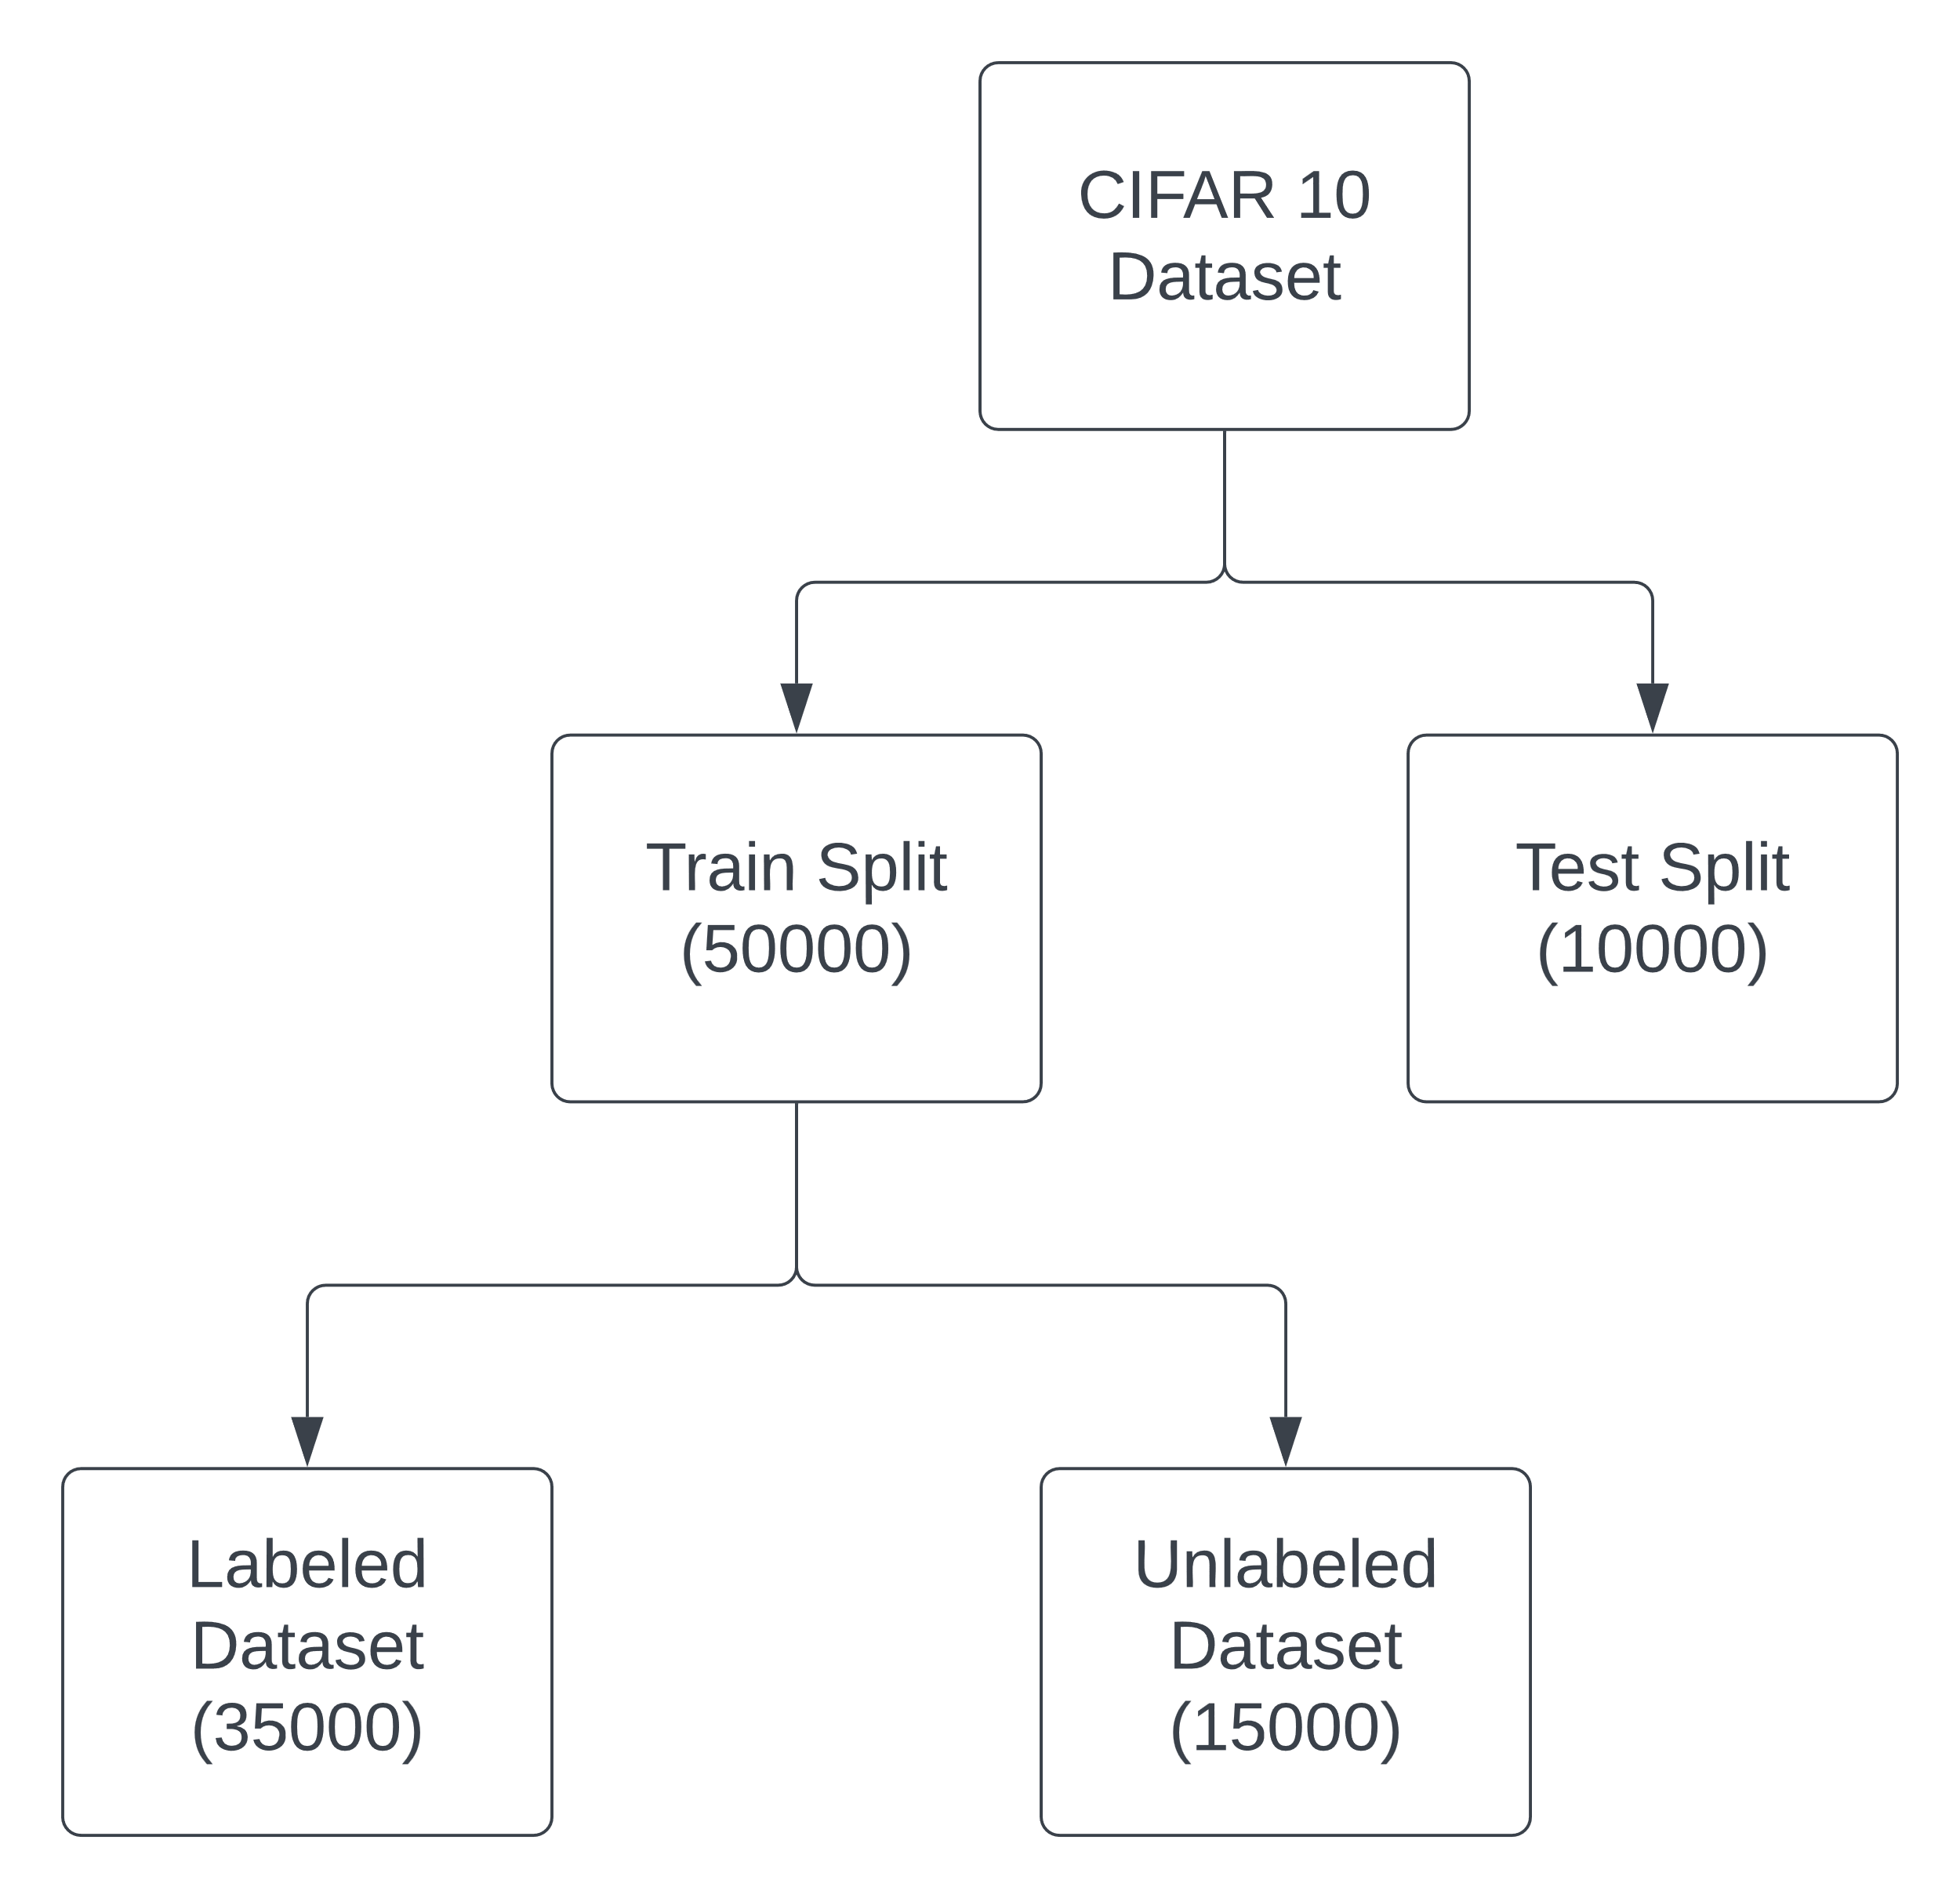
SEMI-SUPERVISED LEARNING SETUP
We firstly pretrain a model using only labeled dataset.
Then we used pretrained model in semi-supervised learning process.
70 epoch with parameters:
Learning Rate = 0.001,
Batch size = 64, Momentum = 0.9
Confidence Threshold = 0.8

Slide 8
SEMI-SUPERVISED LEARNING RESULT
Pretrained model achieved 81.40% accuracy.
This accuracys increased to 84.12% by involving unlabeled data using pseudo-labeling technique.
Pseudo-labeling technique is effective and can be utilized to increase model’s performance.

Slide 9
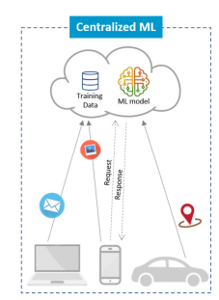
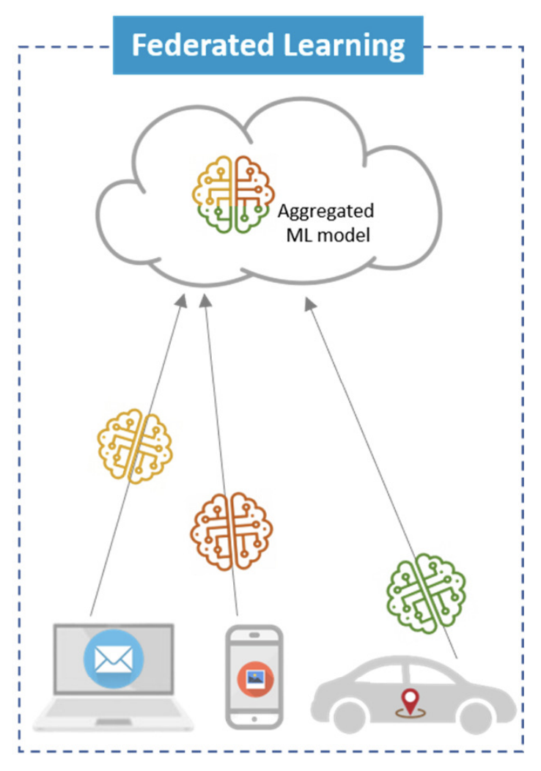
Figure 1. Illustrates Federated Learning, a decentralized model training method where multiple devices collaborate to improve a shared model without exchanging raw data. [4]
FEDERATED LEARNING APPROACH
What is Federated Learning ?
A decentralized machine learning method where multiple devices collaborate to improve a shared model without exchanging raw data
Figure 2. Illustrates tradinitonal centralized learning.[1]
Figure 3. Illustrates Federated Learning, a decentralized model training method where multiple devices collaborate to improve a shared model without exchanging raw data. [1]
[1] S. Abdulrahman, A. Mourad, H. Tout, C. Talhi “A Survey on Federated Learning: The Journey From Centralized to Distributed On-Site Learning and Beyond“.

Slide 10
FEDERATED LEARNING SETUP
We have total 100 device.
Each device has 500 training images.
Sampling based on independent and identically distributed (IID) concept.
Images on the devices, are independent of each other and are drawn from the same probability distribution.
Number of selected device in each round for training: 20
75 communication round
10 local epoch
Learning rate = 0.01, Momentum= 0.9, Batch size = 64
FedAvg algorithm on the server side.

Slide 11
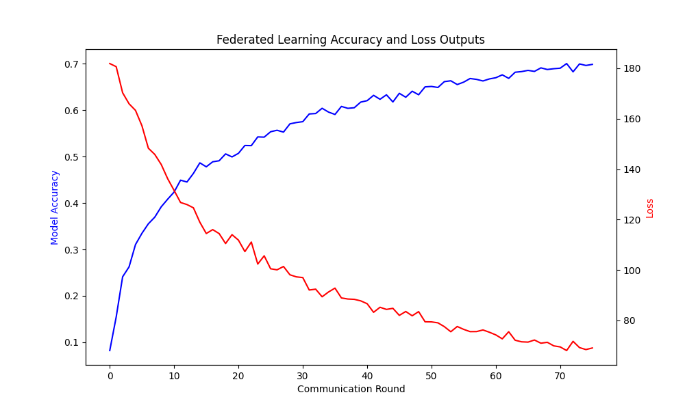
FEDERATED LEARNING RESULT
Test set left on the server side and we used to evaluate the performance of the global model after each round.
We reached approximately %70 accuracy.
Figure 4. Accuracy and loss values in each communication round.

Slide 12
THANK YOU FOR LISTENING!

